Slide 1
DIVIDEMIX: LEARNING WITH NOISY LABELS AS SEMI-SUPERVISED LEARNING
Xiaoyu Li
2020.12.2

Slide 2
Background
1. Samples with noisy label is not inevitable.
It is extremely expensive and time-consuming to label extensive data with high-quality annotations
2. DNNs can easily overfit to noisy labels and results in poor generalization performance.

Slide 3
Motivation
Existing methods to learn with noisy labels and to reduce annotation cost.
loss correction approach
correct label with prediction
mixup augmentation
design a reliable criteria to select clean samples
train two networks where each network selects small-loss samples in a mini-batch to train the other
semi-supervised learning (SSL)
leverage unlabeled samples by enforcing the model to produce low entropy predictions on unlabeled data or consistent predictions on perturbed input. MixMatch unifies several dominant SSL approaches in one framework and achieves state-of-the-art performance

Slide 4
Motivation
Existing methods to learn with noisy labels and to reduce annotation cost.
loss correction approach
semi-supervised learning (SSL)
Despite the individual advances in LNL and SSL, their connection has been underexplored

Slide 5
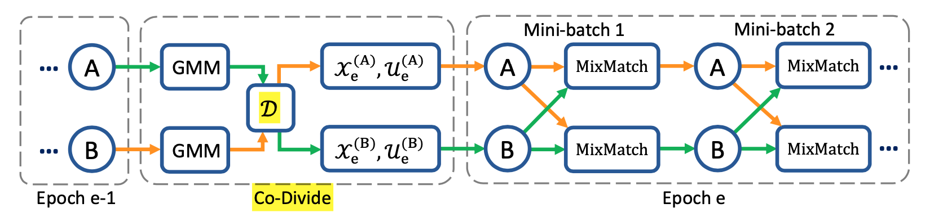
Method
DivideMix: addresses learning with label noise in a semi-supervised manner.

Slide 6
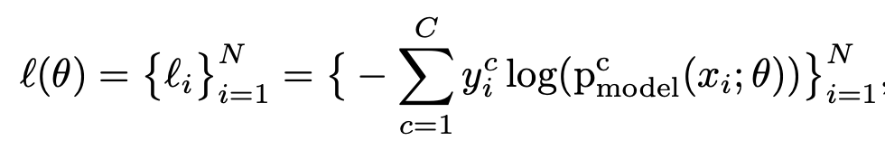

Method Co-Divide
To fit a two-component GMM to l using the Expectation-Maximization algorithm.
For each sample, its clean probability w_{i} is the posterior probability p(g|li), where g is the Gaussian component with smaller mean (smaller loss)
To divide with threshold τ on w_{i} .

Slide 7
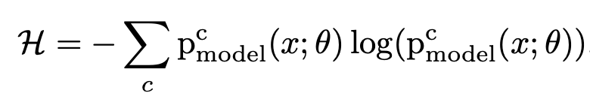
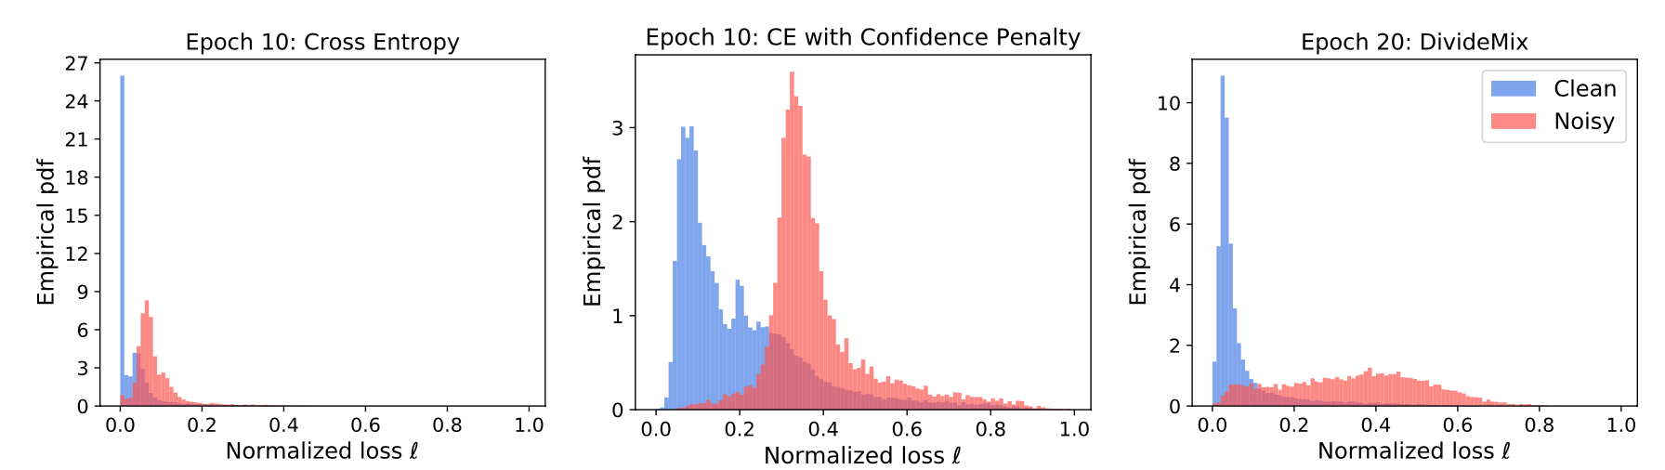
Method Co-divide
Confidence Penalty for Asymmetric Noise
for asymmetric (i.e. class-conditional) label noise, the network would quickly overfit to noise during warm up and produce over-confident (low entropy) predictions, which leads to most samples having near-zero normalized loss. → add entropy during warm up

Slide 8



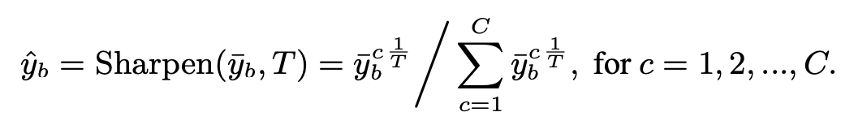
Method
We get and B as batch size
Two improvements to MixMatch:
CO-REFINEMENT
linearly combining the ground-truth label y_{b} with the network’s prediction p_{b} (averaged across multiple augmentations of x_{b}), guided by the clean probability w_{b} produced by the other network
2. CO-GUESSING

Slide 9
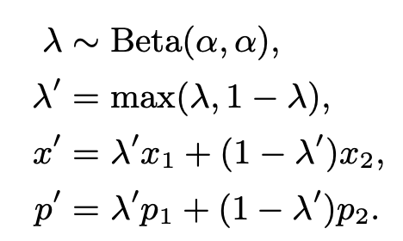
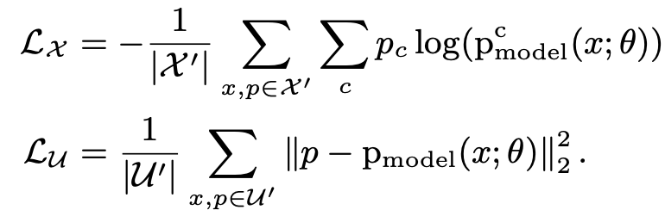
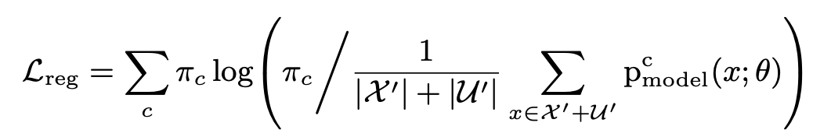

Method
CO-GUESSING
Having acquired X (and U) which consists of multiple augmentations of labeled (unlabeled) samples and their refined (guessed) labels, we follow MixMatch to “mix” the data get U’and X’.

Slide 10
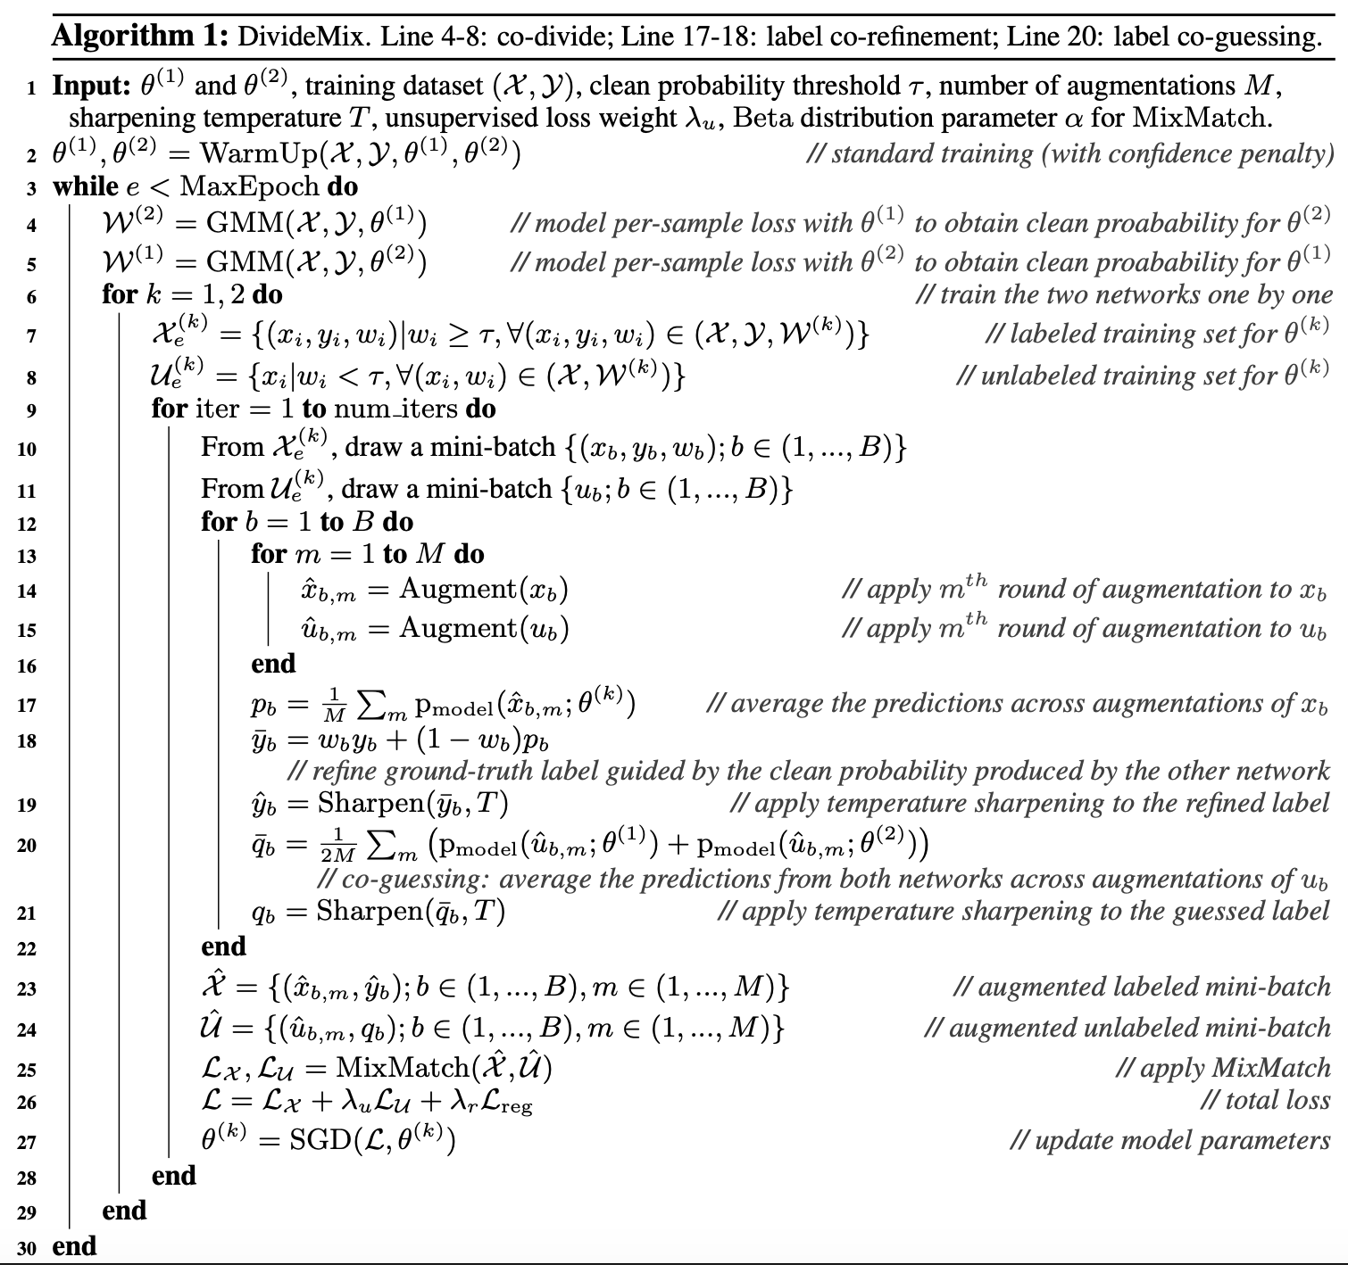
Algorithm

Slide 11
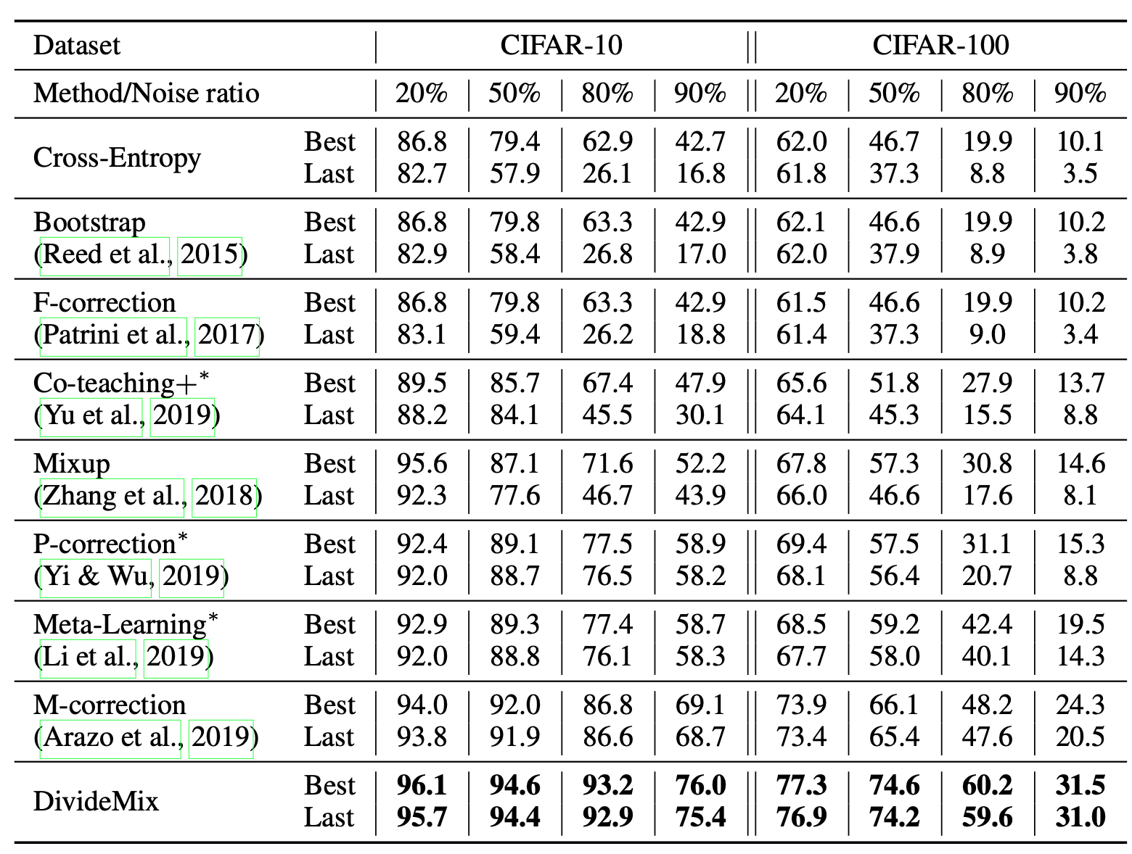
Experiments

Slide 12
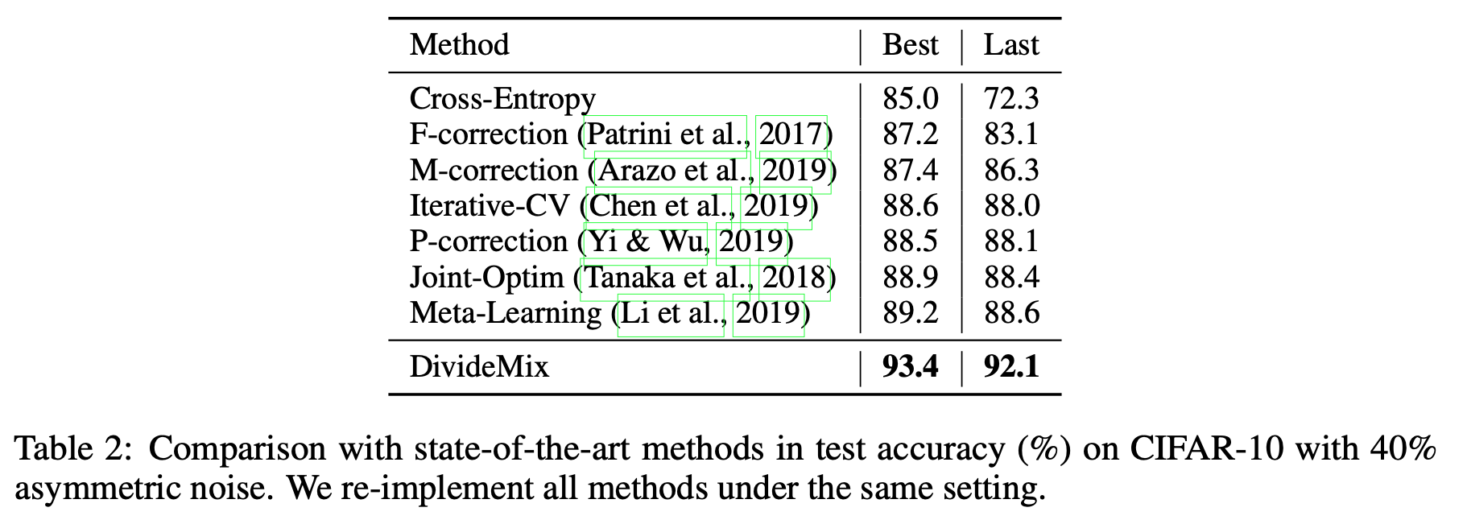
Experiments

Slide 13
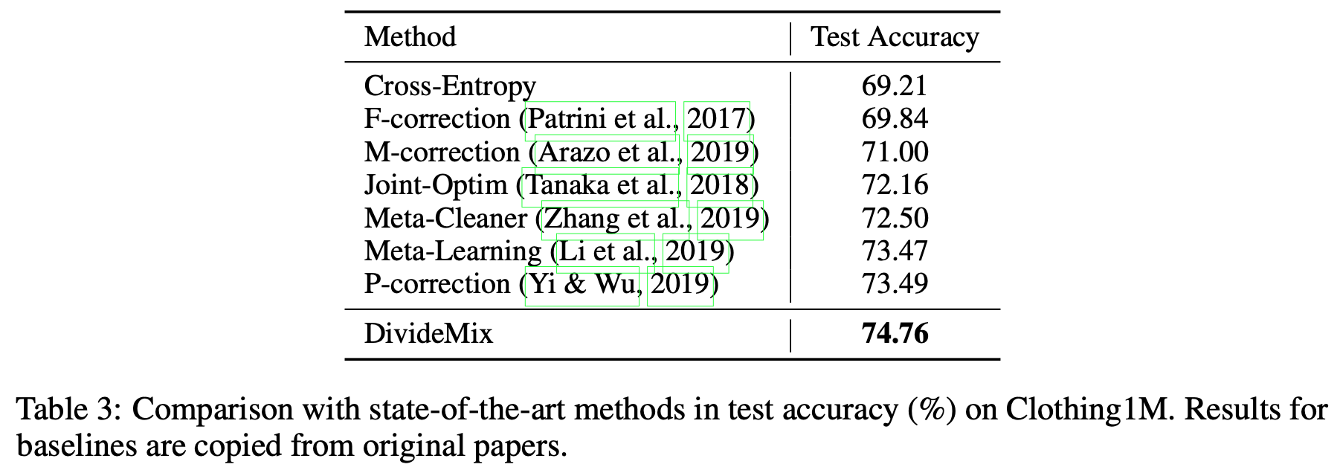
Experiments

Slide 14
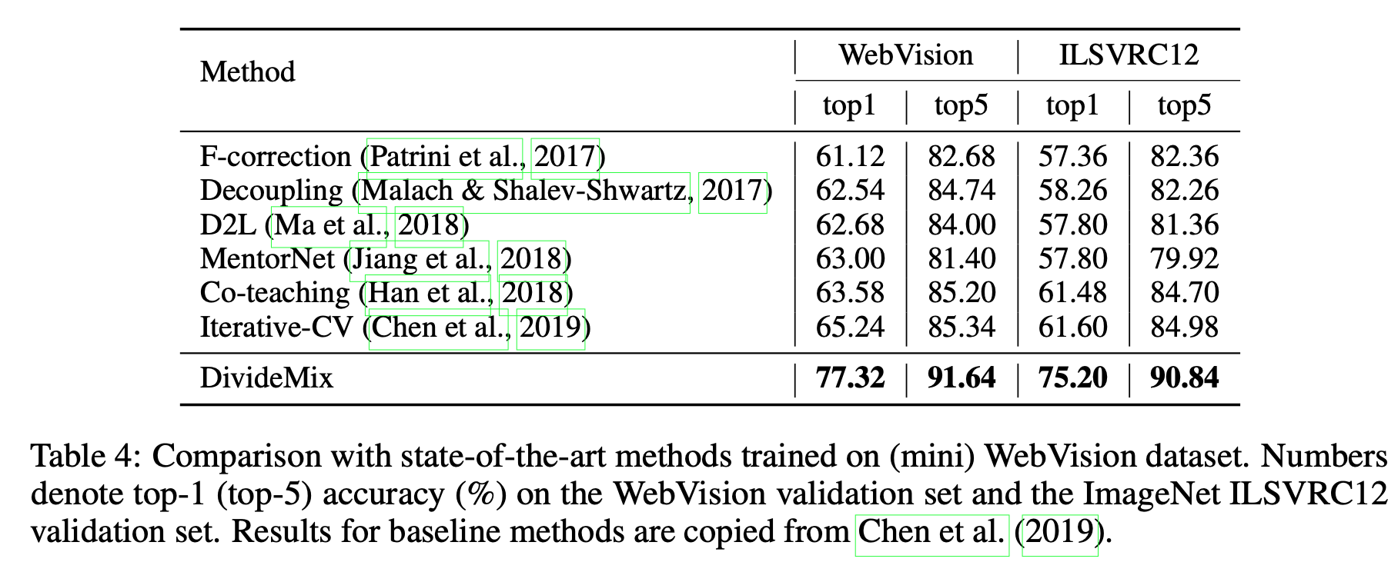
Experiments
Mini： first 50 classes from 1000 classes

Slide 15
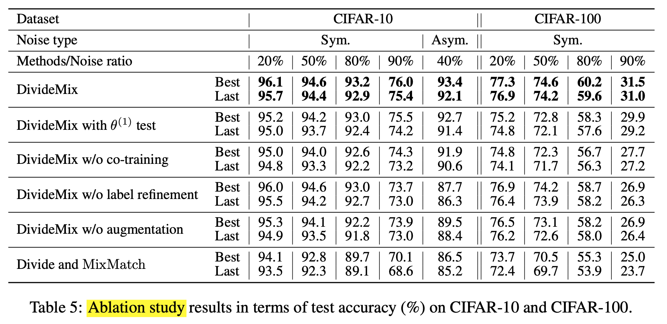
Experiments

Slide 16
Thanks
Q&A

Slide 17
Label noise detection
Training setting (Network structure, loss, epoch, batch size, lr…)
Capability to fit samples
Robust to noisy sample (larger gradient assigned to clean sample)
Indicator (CE, Reversed CE, MAE, MSE …)
Larger value for clean/noisy sample
Divider (Clustering: Kmeans, GMM, BMM)

Slide 18
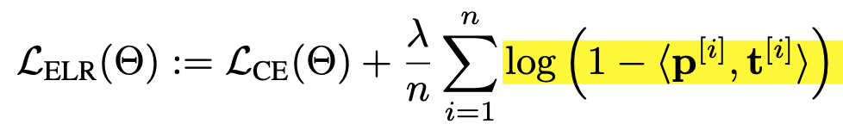
Label noise detection
CE as indicator might not be the best choice. To learn such indicator?
Dense(dot-product ((Output * W1)，(Label * W2))) -> 0~1
Network structure as early-learning regularization
Early-learning regularization is proved effective
Can such regularization be achieved by network update moving average?
Self-labeling instead of clustering?

